Slide 1

CURE Web App
Brian Gougnhour
Nakava Kibunzi
Joshua Brown
Chauncey Davidson
Charles S. Stamey

Slide 2

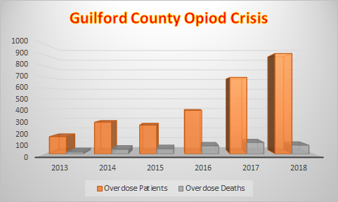

Background
Each year numbers climb relating to opioid overdose deaths in Guilford County.
From 2013 there were 157 OD patients with 17 deaths, compared to 2017, where there were 695 OD patients with 104 deaths.
Conversely in 2018, there were 912 overdose patients reported and 79 deaths. This indicated that the program GCSTOP initiated last year is improving.

Slide 3
Overview
The CURE application for Android and iOS exists as a medium in which users can seek the help they need, connect with professionals and other survivors of opioid addiction as well as provide useful tools to keep people on track with prevention techniques.

Slide 4

CURE Goals
Giving people more personal access to trusted services in their local area.
Making resources more accessible.
Creating a new design template for the CURE application.
With substance abuse being such a specific field, an abundance of data has yet to be analyzed.

Slide 5
CURE Goals Continued…
Some of the planned features include:
Location services for finding centers and resources near you.
Auto-dial for getting help in an emergency.
Calendar Appointments.
Goal tracking with notification updates.
Event updates for community outreaching.
Text help

Slide 6
Product Specifications
Creating a web application that can be ported to both Android and iOS devices.
The primary audience for this application will be families affected by the opioid crisis, and individuals suffering from it.
The particular genre for target audience is self-help and organization.

Slide 7
Libraries and Frameworks
Utilizing the Meteor API to develop the application.
The primary language is going to JavaScript translated with Cordova for easier portability to iOS, and Android.
The mapping functionality will use mongo DB, to hold the location data then integration using the Google Maps API or Arc GIS.

Slide 8
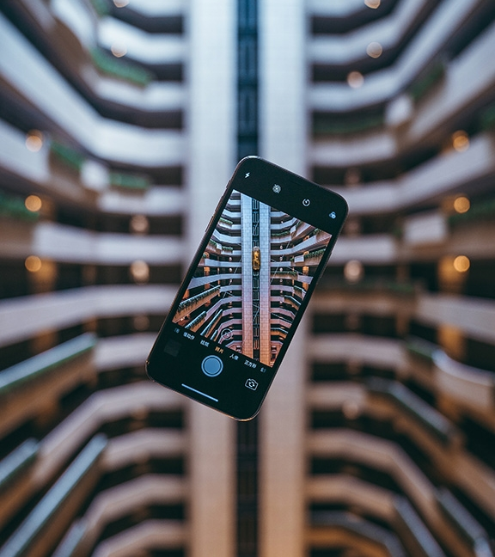

Functionality
Calendar
Public calendar which automatically populates events and dates.
Private calendar which can pull from the public calendar.
Hot Dial
Numbers for help facilities are designed with buttons which will immediately call the facilities.
Goal Tracking Log
Users can keep a log of progress and interactions.

Slide 9
Functionality cont.
Text Help
Anonymous texting provided for users seeking help.
Location Services
Viewing facilities and event locations on a map.
Courses and Training
Querying events and online courses from outside sites.

Slide 10
Usability
Using swipe function of phone to create smooth transitions between tabs
The map will provide nodes that the user can touch to show information and pictures of the facilities.
From the public calendar user can add events manually to their private calendar.

Slide 11
Usability
Hot dial allows users to touch a number and get context option for immediate call.
Text help offers users a quick easy way to message help providers.
Course training provides interactive menus view available classes.
Makes available to update calendar.

Slide 12

System Details
Android 4.4 (KitKat) or iOS version 9.3.5 and above
For Apple, iPhones 4s and up.
Goal of 100 MB RAM maximum required
Mongo Database designed from Meteor
No special software needed for user.

Slide 13

Security
Users will need to login using an account stored in our database system.
The database will be using SHA256 hashing to keep the passwords protected.
Privacy is extremely important, so all information will be encrypted if sent to other users within the network or to outside applications.

Slide 14

Any Questions?
We are excited to see where this project will take us.
THANK YOU!
Visit us at
https://github.com/stevieclean/UNCG-CSE-Senior_Proj

